Slide 1
TEACH-IN
REPRODUCTIVE JUSTICE

Slide 2
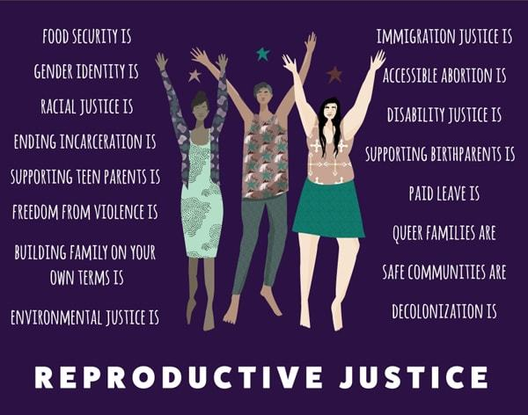
Reproductive Justice: History to Mobilization

Slide 3
Themes
What is “reproductive justice”? The prism of Sistersong/Trustbackwomen.org
How have social inequalities limited women’s reproductive choices through history?
Many different histories of reproductive coercion (criminalization of contraception and abortion in the 19th century, the law of slavery, forced sterilization)
The legacies of the “privacy” argument in Roe v. Wade: potentially transformative, yet highlights limits of the personal, individual “choice paradigm”
How the Trump agenda hurts reproductive justice in all its dimensions
Multi-pronged activism: legal challenge, electoral politics, plus social movements

Slide 4
What is “reproductive justice”?
According to Rickie Solinger “Reproductive justice says that in order to live safe and digniﬁed lives with meaningful possibilities and opportunities, all women must have the right to decide whether to get pregnant and stay pregnant. If they decide to stay pregnant, they must have the right to adequate information and services and personal safety while pregnant. Finally, and this is crucial: every woman must have the right to be the parent of her child and to have access to the resources she needs to raise that child in a safe, healthy, and life-enhancing environment.”

Slide 5
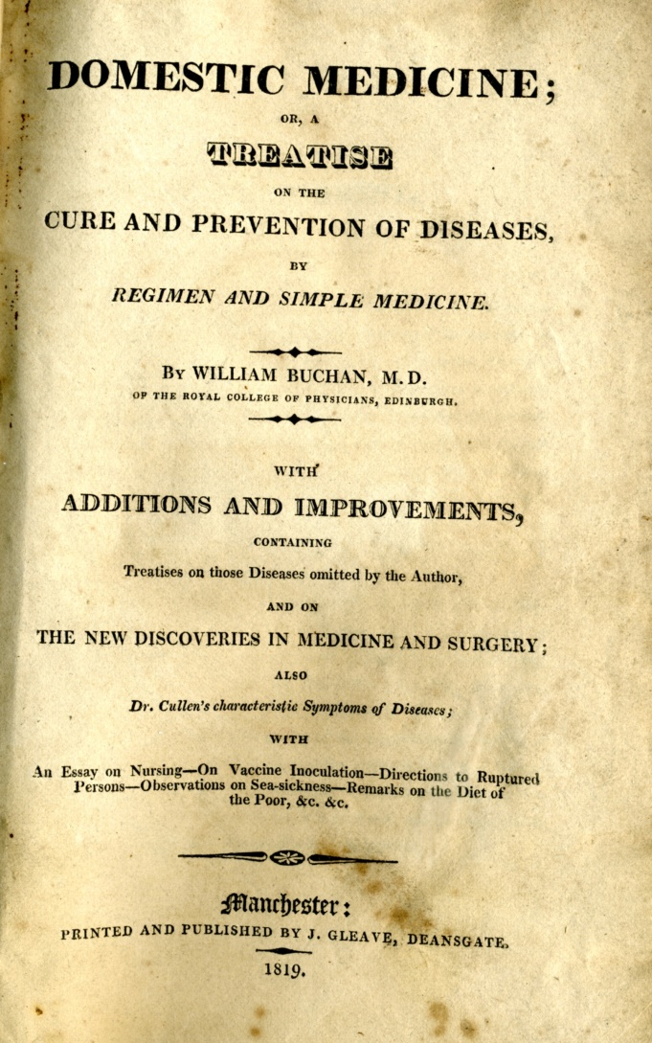
Before Abortion was Criminalized
Treatises on domestic medicine prescribed various methods to help women restore their menstrual flow before “quickening”: “Bloddletting, bathing, iron and quinine concoctions,” and as a last resort, a deadly purgative mixed with warm water.
(James C. Mohr, Abortion in America: The Origins and Evolution of National Policy (New York: Oxford University Press, 1978)

Slide 6
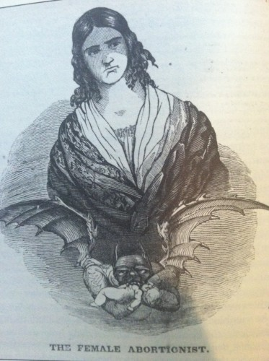
Ad placed by Restell in New York Sun, March 18, 1839
“Female Physician” Madame Restell, described by guidebooks as the “wickedest woman in New York.”
“TO MARRIED WOMEN.—Is it not but too well known that the families of the married often increase beyond what the happiness of those who give them birth would dictate?… Is it moral for parents to increase their families, regardless of consequences to themselves, or the well being of their offspring, when a simple, easy, healthy, and certain remedy is within our control? The advertiser, feeling the importance of this subject, and estimating the vast benefit resulting to thousands by the adoption of means prescribed by her, has opened an office, where married females can obtain the desired information.” Read more: http://www.smithsonianmag.com/history/madame-restell-the-abortionist-of-fifth-avenue-145109198/#0COdqYkcbiobhyv0.99

Slide 7
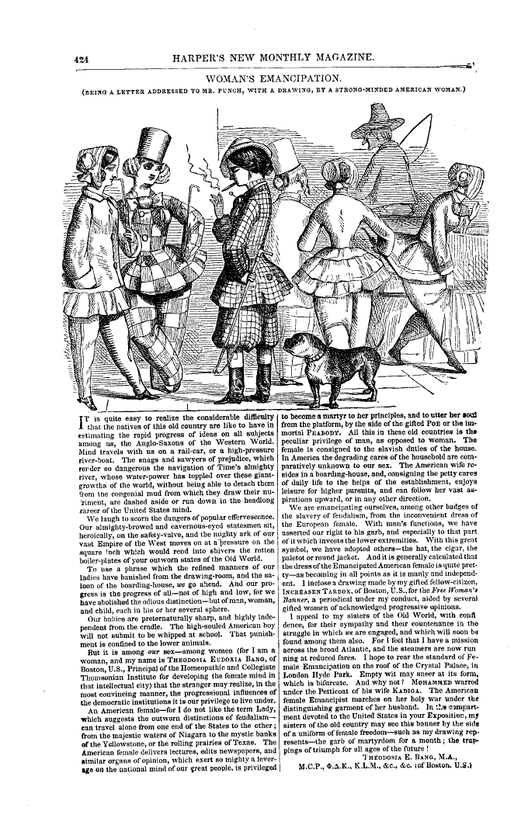
Anxieties over gender norms and expectations in the 19th c century

Slide 8
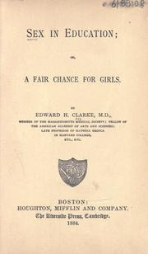
1873 Treatise by Edward H. Clarke, M.D., on women’s education
"There have been instances, and I have seen such, of females... graduated from school or college excellent scholars, but with undeveloped ovaries. Later they married, and were sterile….The system never does two things well at the same time. The muscles and the brain cannot functionate in their best way at the same moment….”

Slide 9
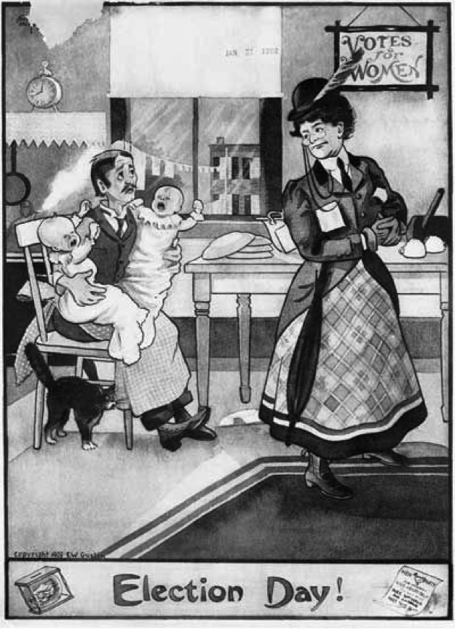
Anti-suffrage cartoon by E.W. Gustin, 1909

Slide 10
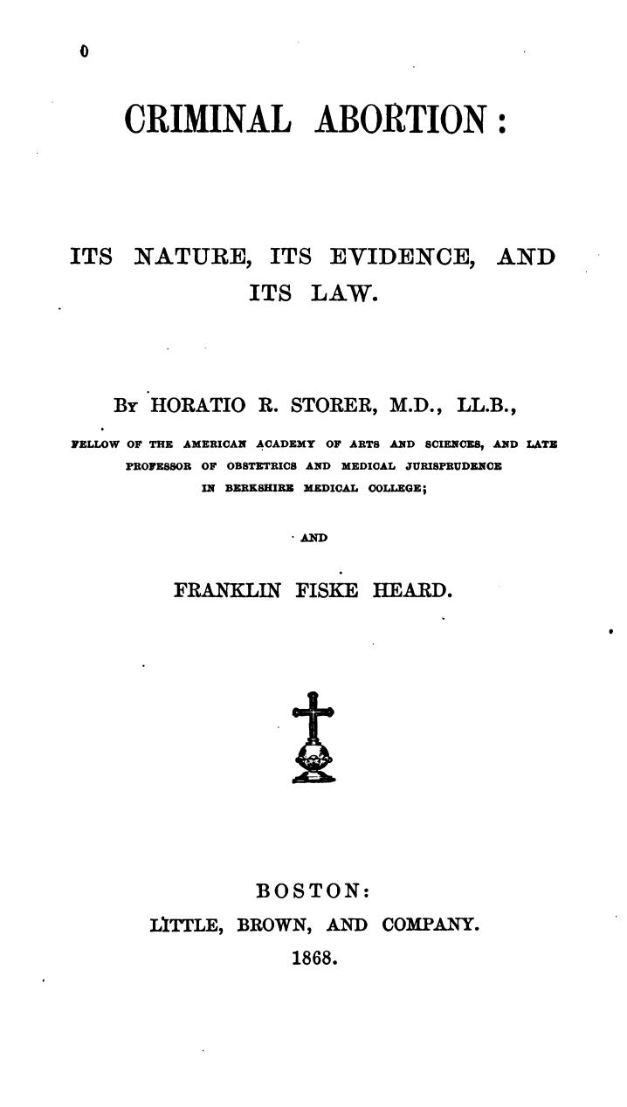

Slide 11
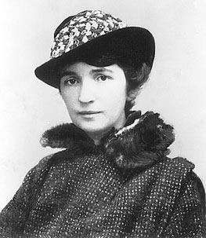
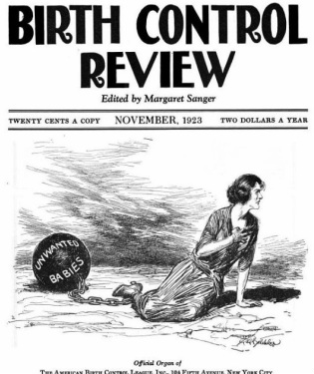
Margaret Sanger and the story of Planned Parenthood

Slide 12
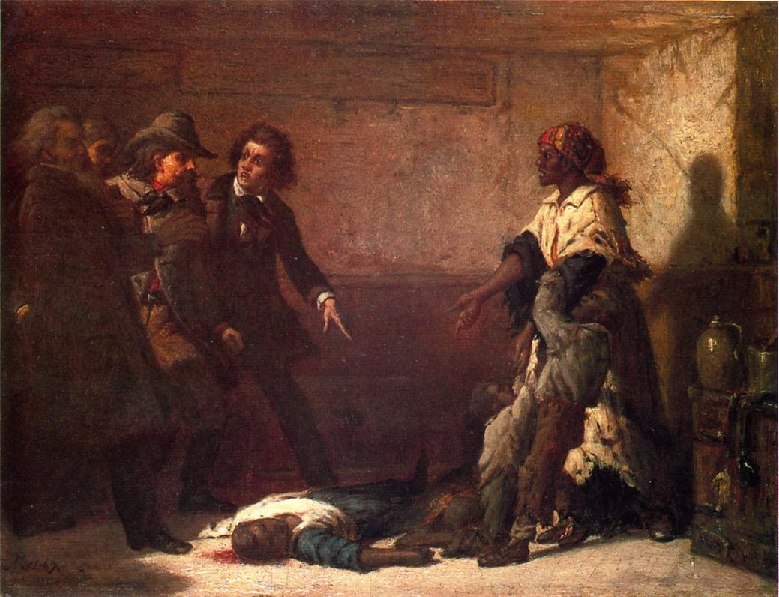
Black Women and Reproductive Control
VIRGINIA SLAVE LAW (1662)
“The Modern Medea” by Kentucky painter Thomas S. Noble (1867)
“Whereas some doubts have arisen whether children got by any Englishman upon a Negro woman should be slave or free, be it therefore enacted and declared by this present Grand Assembly, that all children born in this country shall be held bond or free only according to the condition of the mother; and that if any Christian shall commit fornication with a Negro man or woman, he or she so offending shall pay double the fines imposed by the former act.”

Slide 13
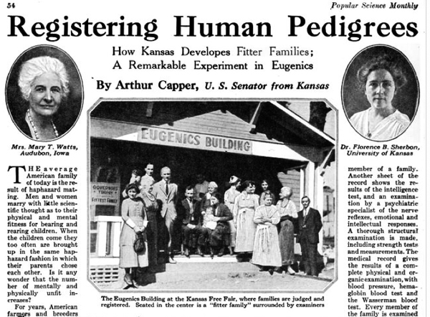
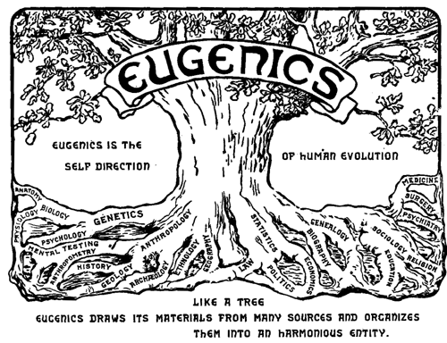
Forced Sterilization
Logo of the Second International Congress of Eugenics, 1921

Slide 14
Legacies of the “privacy” argument in Roe v. Wade
The movement to decriminalize abortion in the 20th century took shape in an era of tension between a resurgent domestic ideal and Cold War conformity on the one hand, and a climate of protest and activism on the other. In this context, abortion rights could be seen as an expression of sexual freedom, self-empowerment, and individualism
Roe v. Wade perpetuated the focus on individualism by grounding abortion rights in privacy, rather than equality.
The privacy framework left a mixed legacy: On the one hand, as Rosalind Petchesky has argued, it established “the [potentially transformative] right to personal ownership of one’s body, its sexuality and reproductive capacity,” as reflected in Lawrence v. Texas. On the other hand, as Andrea Smith as noted, the privacy framework can be interpreted in libertarian ways to mean freedom from government intervention, rather than positive state action to guarantee equal access to guarantee access to abortion services. Making abortion personal and private meant detaching it from the interlocking structures that affect women’s health and well-being, and pit mother against her “unborn baby” (Hence, it is possible to sustain the Hyde Amendment and other state-level restrictions – counseling, waiting periods, parental notification or consent)

Slide 15
Examples of multi-pronged reproductive justice activism by editors of Undivided Rights (marrying litigation with social movements and electoral politics)
In 2004, Black Women’s Health Imperative and National Latina Institute for Reproductive Health, renamed a prochoice march the “March for women’s lives,” to reflect the intersectionality of women’s experiences
Asian American afflilates produced vision papers distinguishing reproduction health from rights and justice
National Latina Institute for Reproductive Health polled the Latino community on reproductive health
Educated and mobilized Latino communities against ‘personhood” laws in Colorado
Removed racist billboards directed at African American women seeking abortions
The Native Youth Sexual Health Network launched media arts justice campaigns to link environmental violence wrought by extractive industries on native women’s reproductive health
SPARK Reproductive Justice Now, in partnership with National Center for Lesbian Rights publicized the benefits of Medicaid expansion on African American LGBTQ communities
Sylvia Rivera Law Project filed a federal class action lawsuit against New York State Department of Health on behalf of two transwomen denied health coverage

